Slide 1
Machine Shop Project Post-Mortem

Slide 2
Average by Section
Overall Average ~91%
Drawings- All(25%) Average: 24.5%
Description of Steps –Prescott (15%) Average: 12.5%
Quality Assessment –Ben and Harper (25%) Average: 22.5%
Design Modifications –Me (10%) Average: 8%
Communication & Professionalism –Me (25%) Average: 23.25%
Generally very strong and appropriate reports

Slide 3
Drawings
Typical Issues (Keep in mind for the future)
- Tolerancing
- Ordinate dimensioning/dimensioning issues
- Neatness
- Notes
Revisions fixed many issues
Generally lost points if small mistakes weren’t fixed

Slide 4
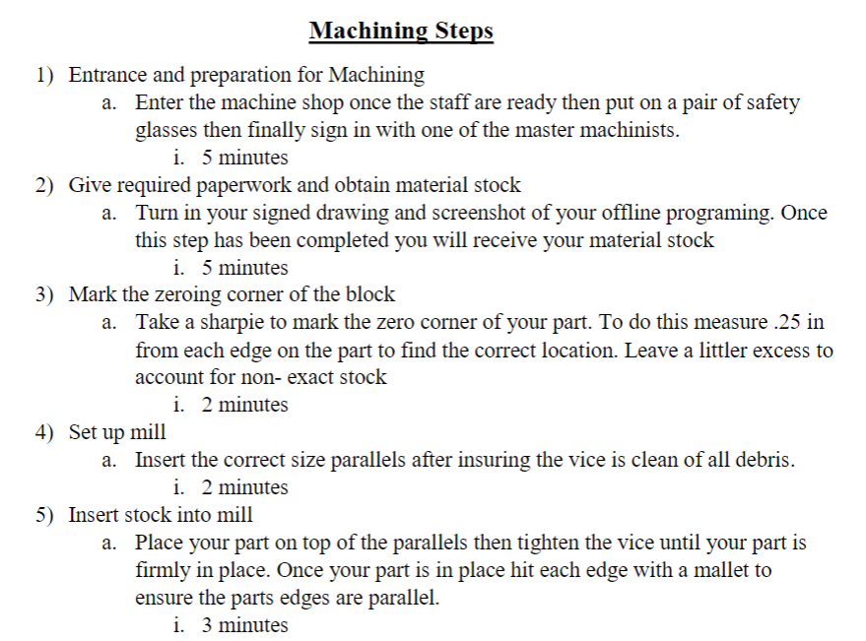
Step Descriptions
Good
Bad
Generally lacking in technical detail or key machining steps (-1)
Machine times needed (-2)
Parallels (-2)

Slide 5
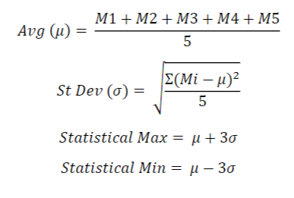
Quality Assessment
Good
Substantial sample of measurements (4-5+)
Tolerance, min, max
Standard Dev.
Statistical Min Max via 6 sigma
Bad
Statistical Analysis (-5)
Single Measurement (-1)
Explanation of Practice (-2)

Slide 6
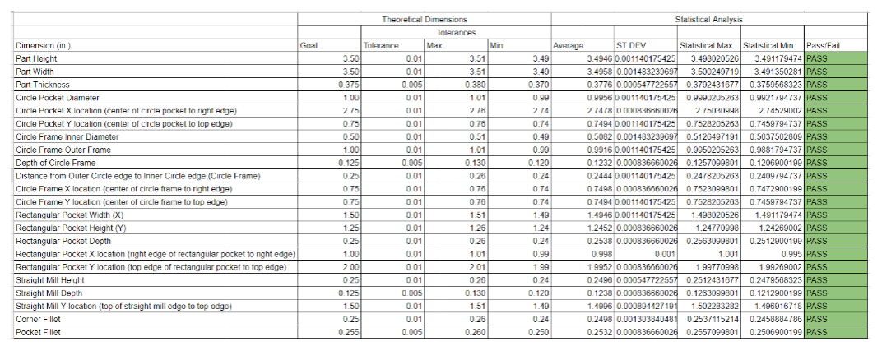
Good Stat Table Example
Note*: Be careful to use significant figures (For future reference)

Slide 7
Design Modifications
Good
Tolerance changes
Size changes
Tool changes
Location changes
Bad
Time Calculation (-2)
Updated Drawing (-2)
Pre-programming
Ideas to effect the actual machining

Slide 8
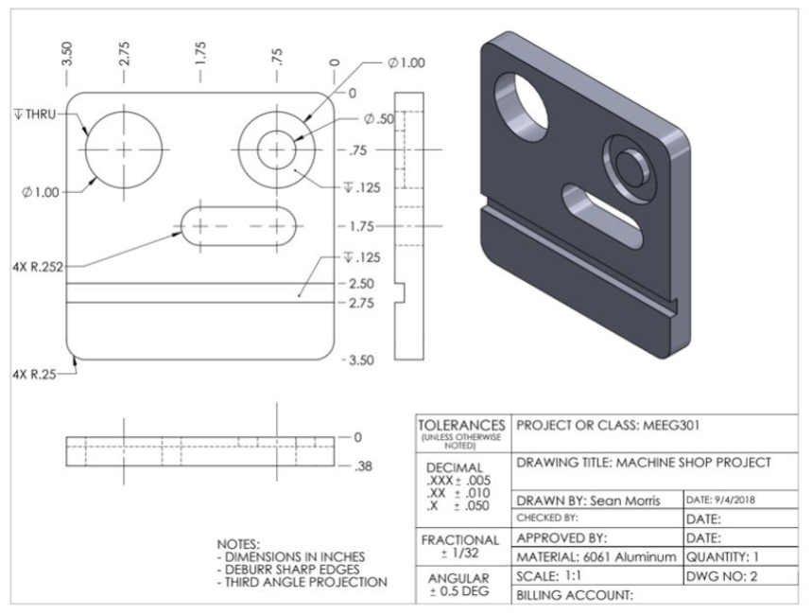
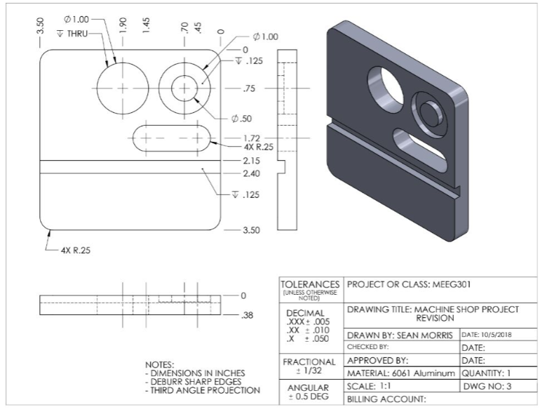
Good Revision Example

Slide 9
Communication & Professionalism
Good
(Most generally fine)
Professional writing style
Understandable and easily conveyed ideas to reader
Bad
Use Appendices (-1)
Figure/table descriptions (-1)
Late to machine (-10)
Digital figure (-3)
Report practices for the future

Slide 10
Questions?
Feel free to send me an email (barberj@udel.edu)

